Slide 1
QHPC EX #3
By: Ryan Silverberg

Slide 2
Types of Companies in HPC
Hardware
Server Designers
Quantum
Storage
Cooling
The classics

Slide 3
Hardware

Slide 4
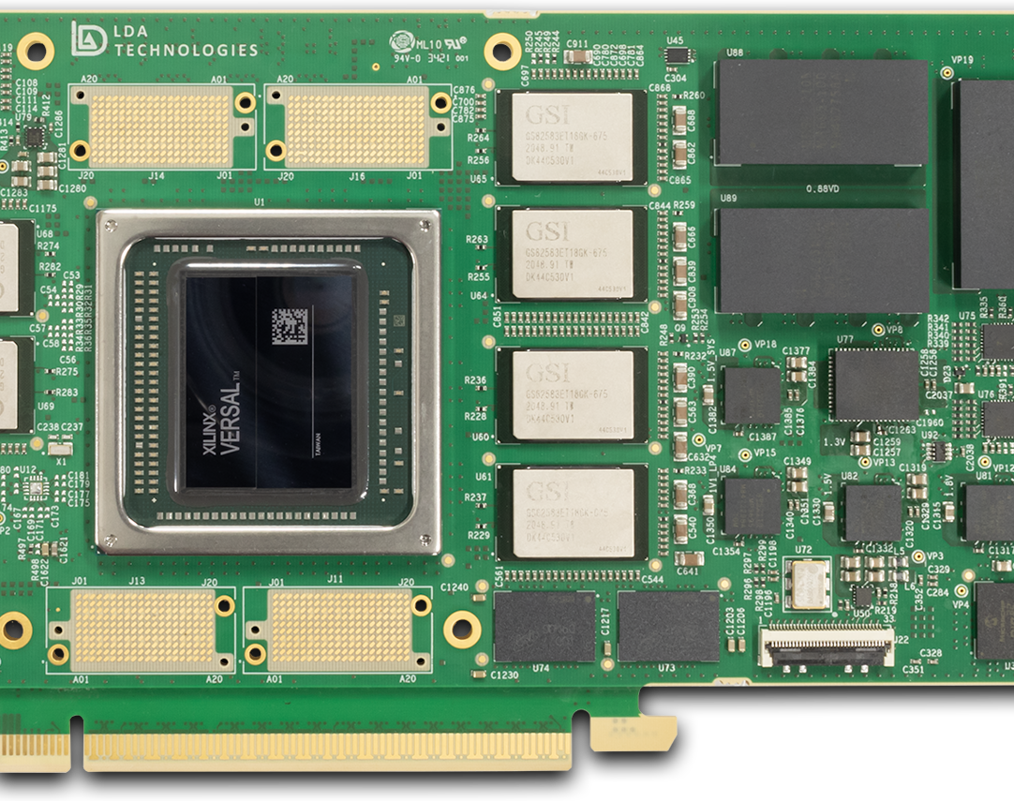
LDA Technologies
Canadian FPGA Company
Ultra low latency FPGA solutions
High performance networking
Specialized hardware
Can synchronize with 50ps of precision

Slide 5

LMS
FPGA based SmartNIC
Called UberNIC
20ns std. dev
Picosecond level synchronization

Slide 6
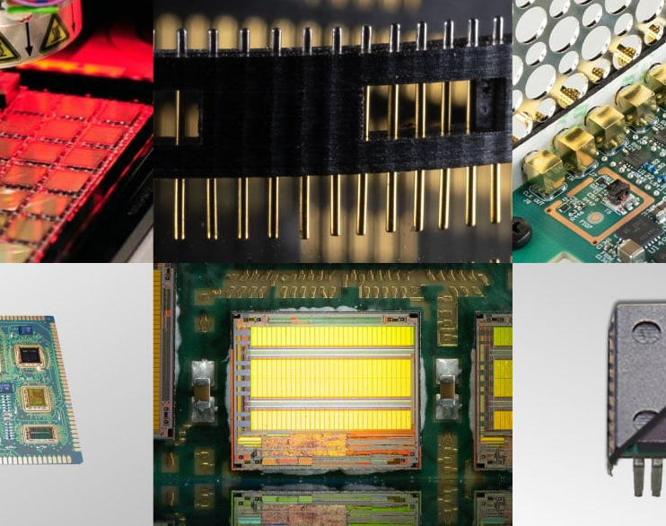
BittWare
Owned by Molex
Vendor agnostic FPGA support
PCIe and CXL interface
HBM2 or GDDR6
LMS works with them and they have a lot of other products

Slide 7
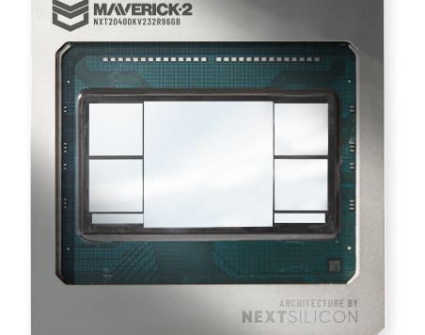
NextSilicon
Design their own chip
Software defined DATAFLOW architecture
Builds a custom graph and the hardware basically learns
Recently signed a deal with Sandia

Slide 8

Preferred Networks
Out of Japan
Make their own hardware, do not rely on third party tech
Topped the Green500 list

Slide 9
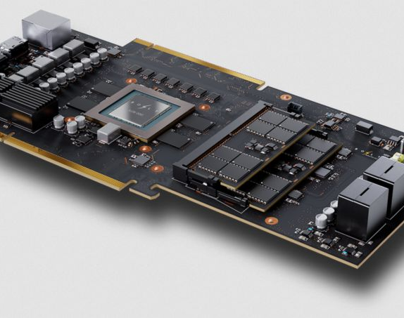
Bolt Graphics
Makes ACTUAL GPUs
Insanely fast
I met the hardware architect
I met the R&D Director (but I left him on read)
10x rendering performance
RISCV based

Slide 10

Cerebras
Wafer scale engine
4 trillion transistors
ONLY focused on AI
I met a distinguished engineer
They have their own assembly

Slide 11
Server Designers

Slide 12
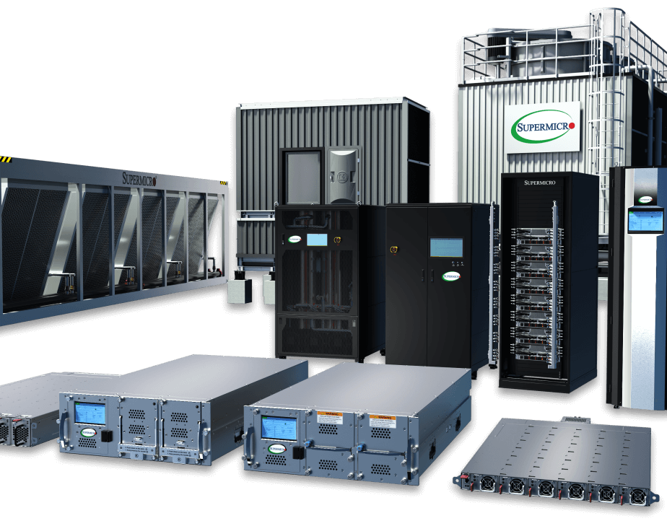
Supermicro
Has a server building block architecture
Designs the full server system
Focused on energy efficiency
Constantly on high end HPC hardware

Slide 13
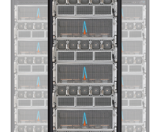
GigaIO
Literally made a server in a suitcase/desktop PC
High network fabrics (6.1 Tb/s)
FabreX is a software defined PCIe based fabric
SuperNODE, rack scale AI system (2x faster)

Slide 14
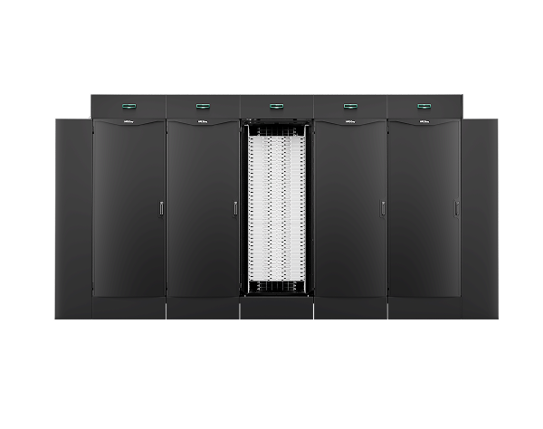
HPE Cray
By far the longest standing ones
Invented Slingshot
Named after Seymour Cray (godfather of HPC)

Slide 15
Quantum

Slide 16
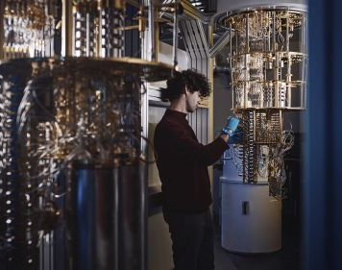
Alice & Bob
French Quantum company
High error resilience qubits
Focused on fault tolerance

Slide 17
Storage

Slide 18
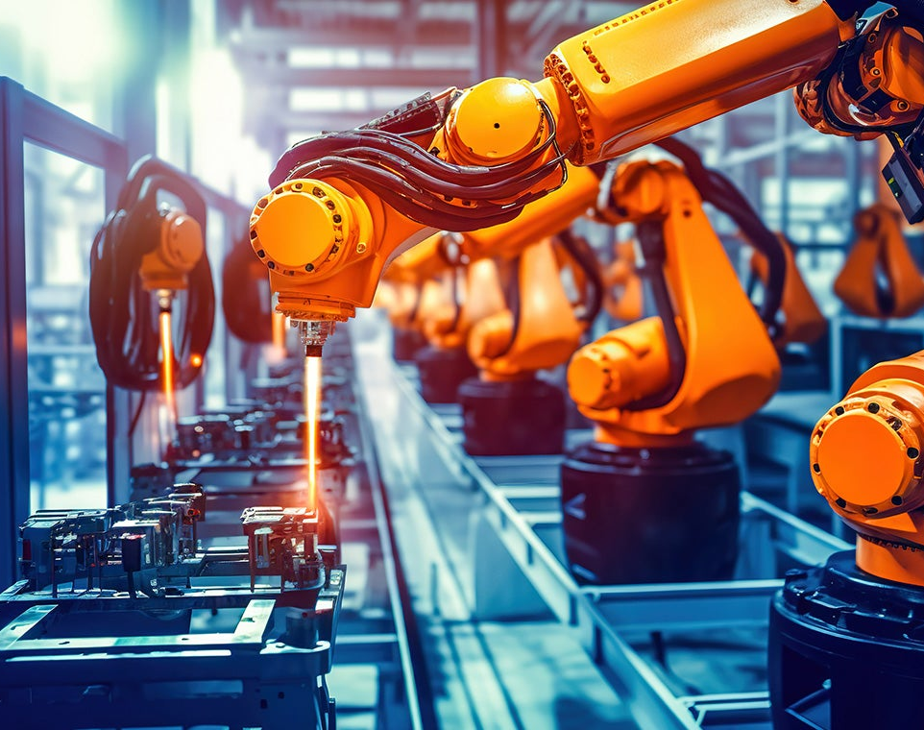
Micron
By far the GOATs
Have a 240 TB SSD
MRDIMM, SOCDIMM…

Slide 19
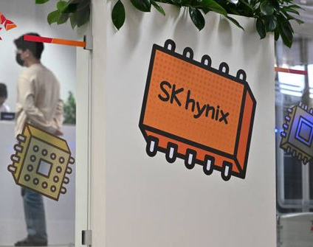
SK Hynix
Focused on HBM
1c nm DRAM and 4 dimension NAND.
Latest is 321 layer NAND flash
Leaders in advanced packaging

Slide 20
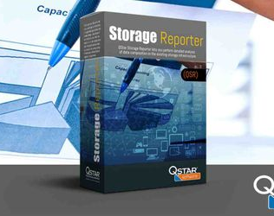
Q-star Technologies
LTO Tapes
System I saw can store 33 PB of data, almost forever.

Slide 21
Cooling

Slide 22

CoolIT Systems
Canadian Company
Leaders in Direct Liquid Cooling
Can handle 4kW of heat
Scalable designs

Slide 23
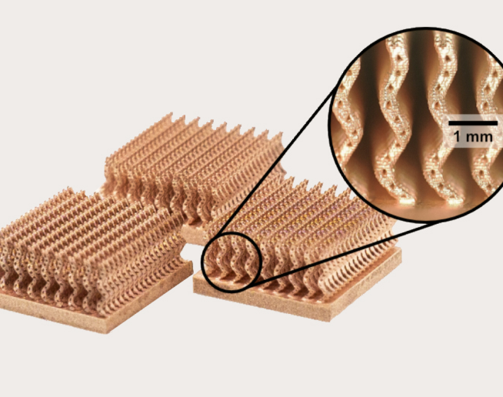
Fabric8Labs
Only included because they do
Additive Manufacturing
Of copper and heat plates

